Slide 1
Instructions for the Tutor / Interventionists
If the student has trouble with the number lines on first slide, please take note
Instructor Slide Only

Slide 2
Our Agenda for the Day
Review of Number Lines
Practice Absolute Value

Slide 3
Fill in the number lines! Count by 1s
We can have more than one student at a time complete these number lines. Fill in the blank spots (on both sides of number)

Slide 4


Fill in the number lines! Count by 1s
We can have more than one student at a time complete these number lines. Fill in the blank spots on each line:

Slide 5


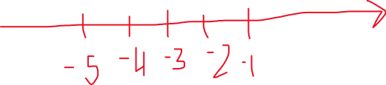

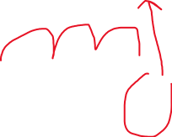

Absolute Value
Whatever is in the absolute value bracket becomes positive.
Example:
| - 5 + 3 | =

Slide 6
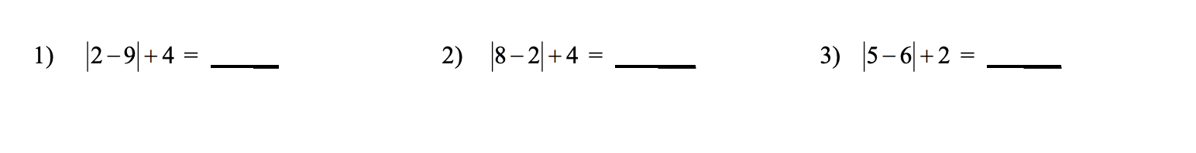
Extra Practice!

Slide 7
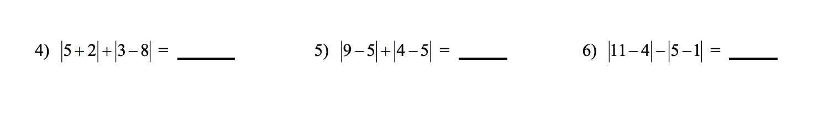
Extra Practice!

Slide 8
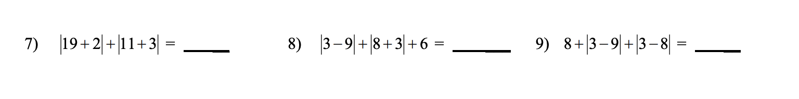
Extra Practice!

Slide 9
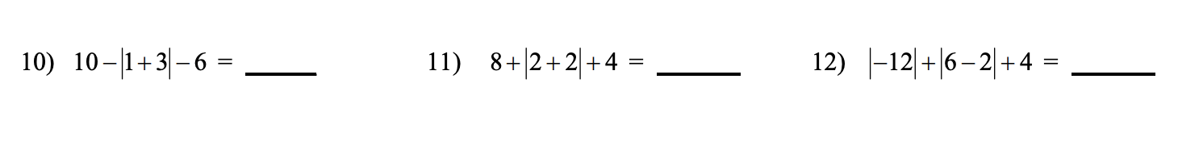
Extra Practice!

Slide 10
Extra Practice!

